Slide 1


Illia Skarha-Bandurov
28/08/2024

Slide 2

Outline
Executive Summary
Introduction
Methodology
Results
Conclusion
Appendix

Slide 3
Executive Summary
Methodologies:
SpaceX Data Collection using SpaceX API
SpaceX Data Collection with Web Scraping
SpaceX Data Wrangling
SpaceX Exploratory Data Analysis using SQL
Space-X EDA DataViz Using Python Pandas and Matplotlib
Space-X Launch Sites Analysis with Folium-Interactive Visual Analytics and Ploty Dash
SpaceX Machine Learning Landing Prediction
Results:
EDA results
Interactive Visual Analytics and Dashboards
Predictive Analysis(Classification)

Slide 4
Introduction
Project background and context
SpaceX advertises Falcon 9 rocket launches on its website with a cost of 62 million dollars; other providers cost upward of 165 million dollars each, much of the savings is because SpaceX can reuse the first stage. Therefore if we can determine if the first stage will land, we can determine the cost of a launch. This information can be used if an alternate company wants to bid against SpaceX for a rocket launch.
Problems you want to find answers
In this capstone, we will predict if the Falcon 9 first stage will land successfully using data from Falcon 9 rocket launches advertised on its website.

Slide 5

Section 1

Slide 6
Methodology
Executive Summary
Data collection methodology:
Describe how data was collected
Perform data wrangling
Describe how data was processed
Perform exploratory data analysis (EDA) using visualization and SQL
Perform interactive visual analytics using Folium and Plotly Dash
Perform predictive analysis using classification models
How to build, tune, evaluate classification models

Slide 7
Data Collection
Request to the SpaceX API
Gathering SpaceX’s past launch data using their own open-source API.
Retrieved and processed this data with GET request.
Ensured the data included only Falcon9 launches
Filled in missing payload weights from secret missions with average values.
2. Web Scraping
Requested past Falcon 9 and Falcon Heavy launch data from Wikipedia’s relevant page.
Accessed the Falcon 9 Launch page.
Extracted all the column names from the HTML table.
Parsed and transformed the table into a Pandas data frame suitable for analysis.
Using SpaceX REST API
Returning SpaceX data in .JSON
SpaceX API
Normalise data into csv files
Ready for Data consideration and wrangling
Get HTML response from Wikipedia
Extract Data using beautiful soup
Web Scrapping

Slide 8
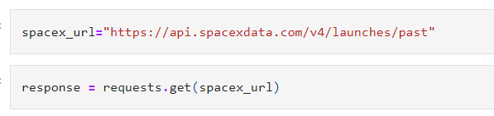
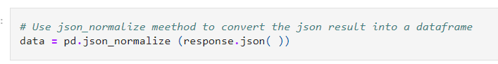
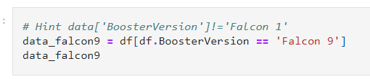
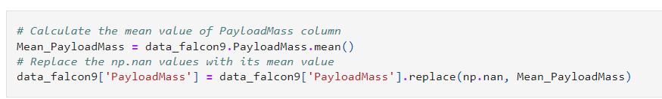
Data Collection – SpaceX API
1. Get request to rocket launch data using API
2. Use json_normalize method to convert json file into Pandas dataframe
1.
2.
4. Perform data cleaning and filling missing values
3. Filter the dataframe to only include Falcon 9 launches
3.
4.
Link to the Notebook: https://github.com/Illia-Skarha-Bandurov/IBM-Data-Science/blob/main/1.%20Lab%201%20Collecting%20the%20data.ipynb

Slide 9
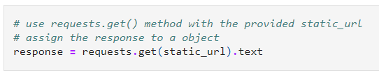
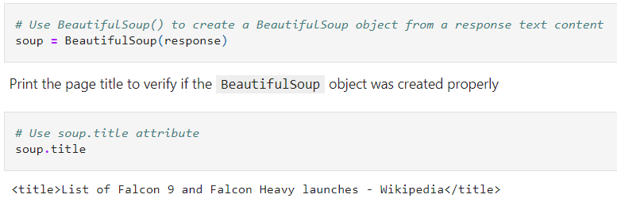
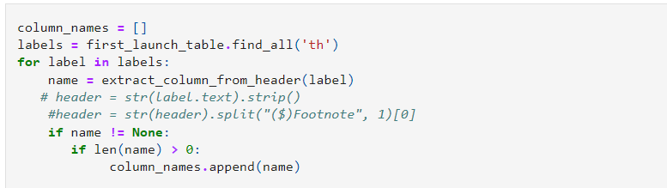
Data Collection - Scraping
1. Use HTTP GET method to request the Falcon 9 Launch HTML page
2. Create BeautifulSoup object from the HTML response
1.
4. Create a dataframe by parsing the launch HTML tables
3. Use extract_column_from_header() to extract column names individually
2.
5. Export data to CSV
3.
Link to the Notebook: https://github.com/Illia-Skarha-Bandurov/IBM-Data-Science/blob/main/2.%20Webscraping.ipynb

Slide 10
Data Wrangling
First step was using Exploratory Data Analysis by identifying and calculating the missing values in each attribute and identifying which columns are numerical and categorial.
Next, calculating the number of launches in each site and the number and occurrence of each orbit.
Also, the number and occurrence of mission outcome at each orbit was calculated.
Finaly, creation a landing outcome label from outcome column.
Link to the Notebook: https://github.com/Illia-Skarha-Bandurov/IBM-Data-Science/blob/main/3.%20Lab%202%20Data%20wrangling.ipynb

Slide 11
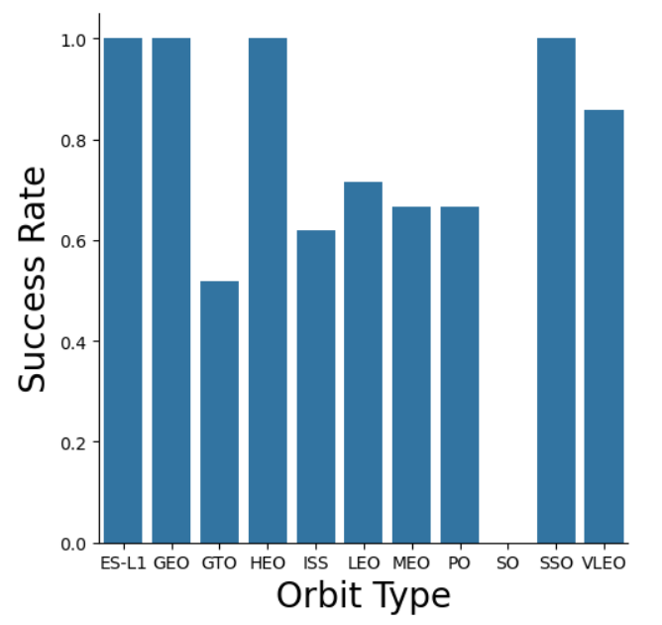
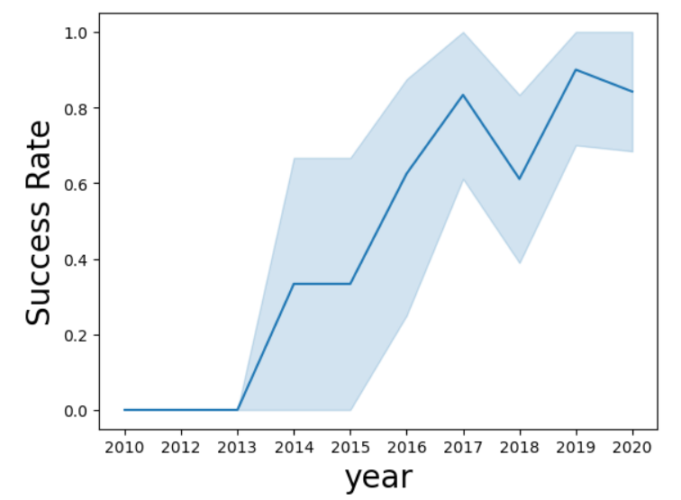
EDA with Data Visualization
We explored the data by visualizing the relationship between flight number and launch Site, payload and launch site, success rate of each orbit type, flight number and orbit type, the launch success yearly trend.
Link to the Notebook: https://github.com/Illia-Skarha-Bandurov/IBM-Data-Science/blob/main/5.%20Assignment%20Exploring%20and%20Preparing%20Data.ipynb

Slide 12
EDA with SQL
We loaded the SpaceX dataset into a PostgreSQL database. EDA with SQL to get insight from the data applied.
Queries to find out for instance:
The names of unique launch sites in the space mission.
The total payload mass carried by boosters launched by NASA (CRS)
The average payload mass carried by booster version F9 v1.1
The total number of successful and failure mission outcomes
The failed landing outcomes in drone ship, their booster version and launch site names.
Link to the Notebook: https://github.com/Illia-Skarha-Bandurov/IBM-Data-Science/blob/main/4.%20Assignment%20SQL%20Notebook%20for%20Peer%20Assignment.ipynb

Slide 13
Build an Interactive Map with Folium
We marked all launch sites, and added map objects such as markers, circles, lines to mark the success or failure of launches for each site on the folium map.
We assigned the feature launch outcomes (failure or success) to class 0 and 1.i.e., 0 for failure, and 1 for success.
Using the color-labeled marker clusters, we identified which launch sites have relatively high success rate.
We calculated the distances between a launch site to its proximities. We answered some question for instance:
Are launch sites near railways, highways and coastlines.
Do launch sites keep certain distance away from cities.
Link to the Notebook: https://github.com/Illia-Skarha-Bandurov/IBM-Data-Science/blob/main/6.%20Launch%20Sites%20Locations%20Analysis%20with%20Folium.ipynb

Slide 14
Build a Dashboard with Plotly Dash
We built an interactive dashboard with following steps:
Adding a launch site drop-down input component
Adding a callback function to render success-pie-chart based on selected site dropdown
Adding a ranger slider to selected payload
Adding a callback function to render the success-payload-scatter-chart scatter plot
We were able to find the site which has the largest successful launches, which has the highest success rate, the payload range(s) which has the highest and lowest launch success rate, and F9 booster version which has the highest launch success rate by using the dashboard we built.
Link to the Notebook: https://github.com/Illia-Skarha-Bandurov/IBM-Data-Science/blob/main/7.%20App.py

Slide 15
Predictive Analysis (Classification)
We loaded the data using numpy and pandas, transformed the data, split our data into training and testing.
We built different machine learning models and tune different hyperparameters using GridSearchCV.
We used accuracy as the metric for our model, improved the model using feature engineering and algorithm tuning.
We found the best performing classification model.
Link to the Notebook: https://github.com/Illia-Skarha-Bandurov/IBM-Data-Science/blob/main/8.%20Assignment%20Machine%20Learning%20Prediction.ipynb

Slide 16
Results
Exploratory data analysis results
Interactive analytics demo in screenshots
Predictive analysis results

Slide 17

Section 2

Slide 18
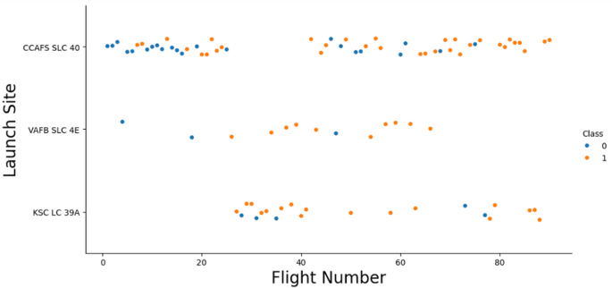
Flight Number vs. Launch Site
From the plot, we found that the larger the flight amount at a launch site, the greater the success rate at a launch site.

Slide 19
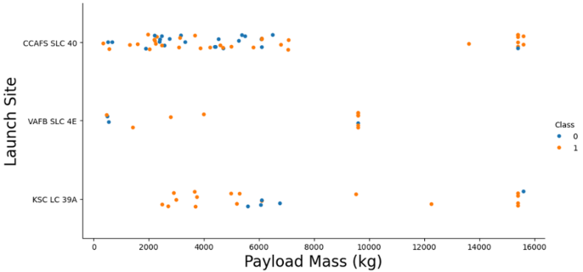
Payload vs. Launch Site
The greater the payload mass for launch site CCAFS SLC 40, the higher the success rate for the rocket.

Slide 20
Success Rate vs. Orbit Type
From the plot, we can see that ES-L1, GEO, HEO, SSO, VLEO had the most success rate which is 1.0

Slide 21
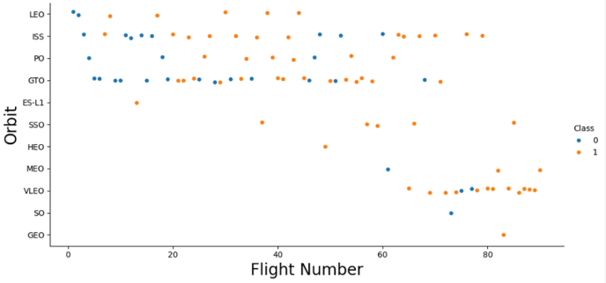
Flight Number vs. Orbit Type
The plot below shows the Flight Number vs. Orbit type. We observe that in the LEO orbit, success is related to the number of flights whereas in the GTO orbit, there is no relationship between flight number and the orbit.

Slide 22
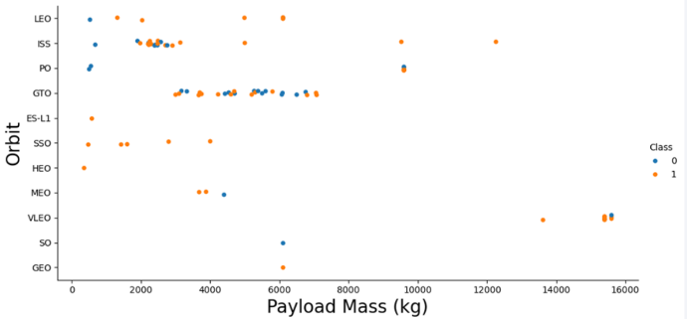
Payload vs. Orbit Type
We can observe that with heavy payloads, the successful landing are more for PO, LEO and ISS orbits.

Slide 23
Launch Success Yearly Trend
As shown in the plot, the success rate was increasing from 2013 to 2020, with a slight decrement in 2018.

Slide 24
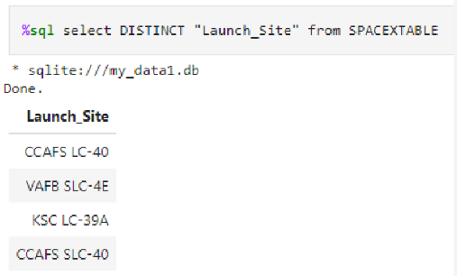
All Launch Site Names
Using the key word DISTINCT we can show the unique unique launch sites from the SpaceX data.

Slide 25

Launch Site Names Begin with 'CCA'
To filter the launch site names begin with ‘CCA’ we used LIKE, and LIMIT to get first 5 results:

Slide 26
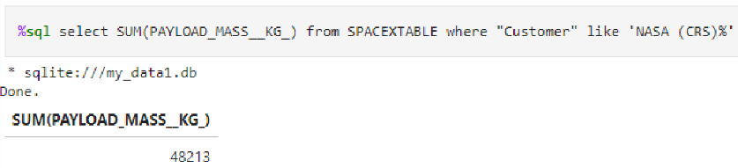
Total Payload Mass
We calculated the total payload carried by boosters from NASA as 48213 using the query below

Slide 27
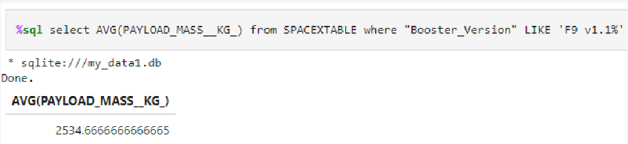
Average Payload Mass by F9 v1.1
The average payload mass carried by booster version F9 v1.1 is approximately 2534 kg.

Slide 28
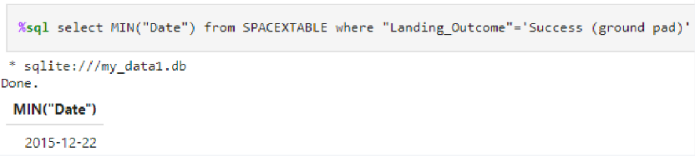
First Successful Ground Landing Date
We observed that the dates of the first successful landing outcome on ground pad was 22nd December 2015

Slide 29
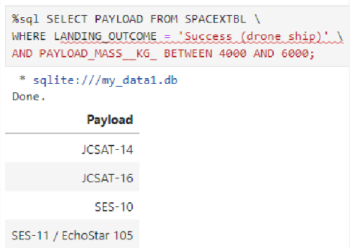
Successful Drone Ship Landing with Payload between 4000 and 6000
Using WHERE clause we filter results for boosters which have successfully landed on drone ship and applied the AND condition to determine successful landing with payload mass greater than 4000 but less than 6000

Slide 30
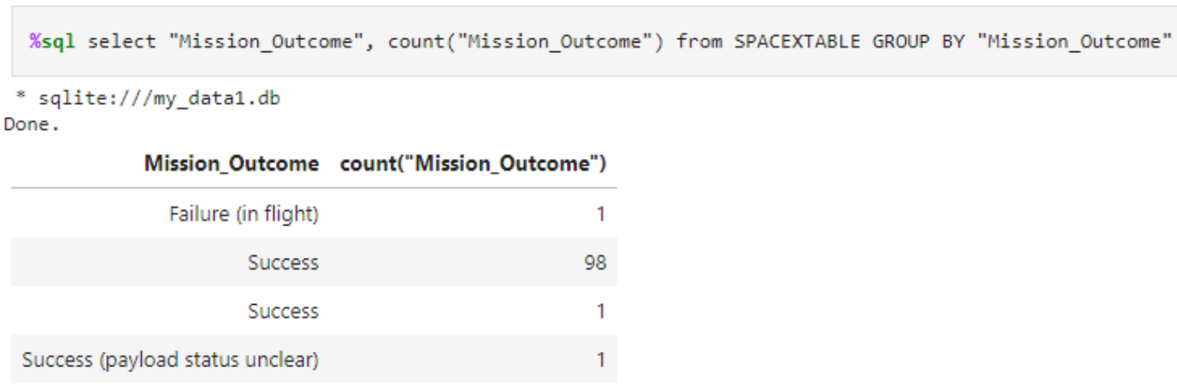
Total Number of Successful and Failure Mission Outcomes
We used the COUNT and GROUPBY key words to calculate the number of successful and failure mission outcomes. According to the results there were 100 successful missions and only 1 failure.

Slide 31
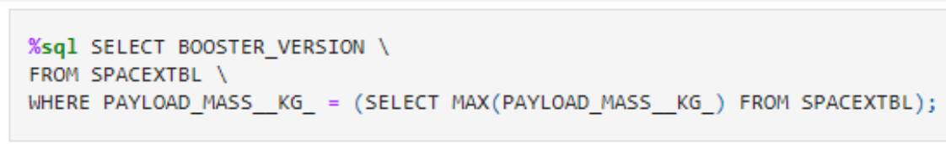
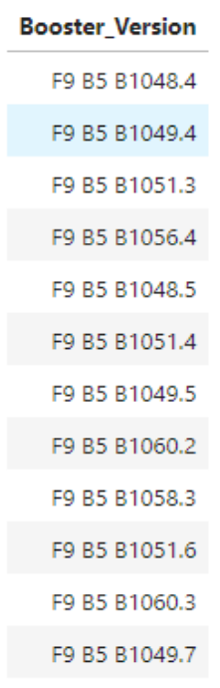
Boosters Carried Maximum Payload
We determined the booster that have carried the maximum payload using a subquery in the WHERE clause and the MAX() function.

Slide 32
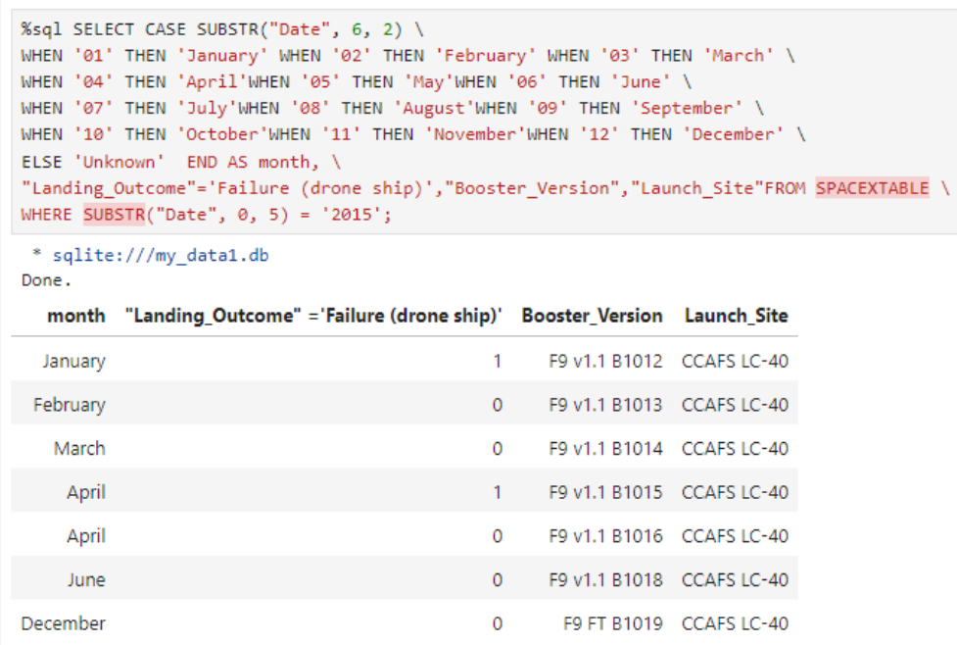
2015 Launch Records
According to the result obtained, we can see that the landing outcome was a failure in the months January and April.

Slide 33
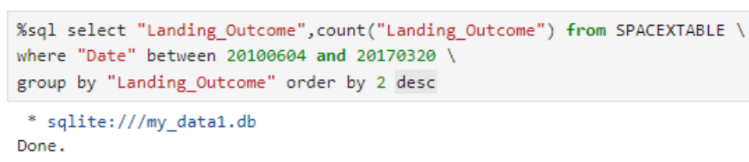
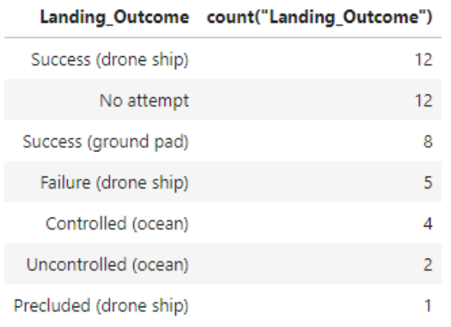
Rank Landing Outcomes Between 2010-06-04 and 2017-03-20
We selected Landing outcomes and the COUNT of landing outcomes from the data and used the WHERE clause to filter for landing outcomes BETWEEN 2010-06-04 to 2010-03-20.
Then we applied the GROUP BY clause to group the landing outcomes and the ORDER BY clause to order the grouped landing outcome in descending order.

Slide 34

Section 3

Slide 35
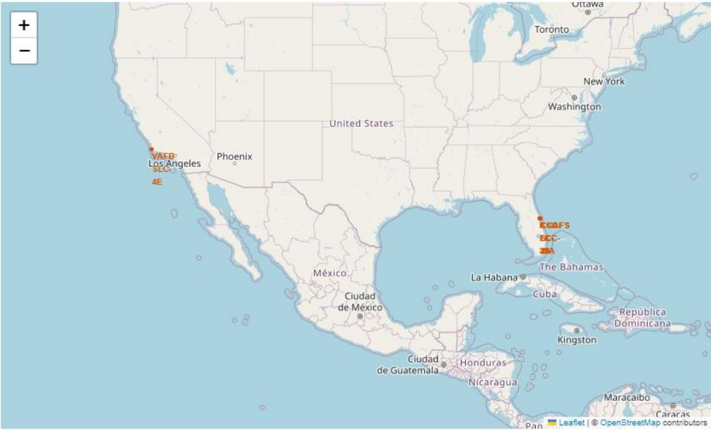
Locations for all launch sites
As shown in the map, SpaceX launch sites are located in coastal areas like Florida and California.

Slide 36
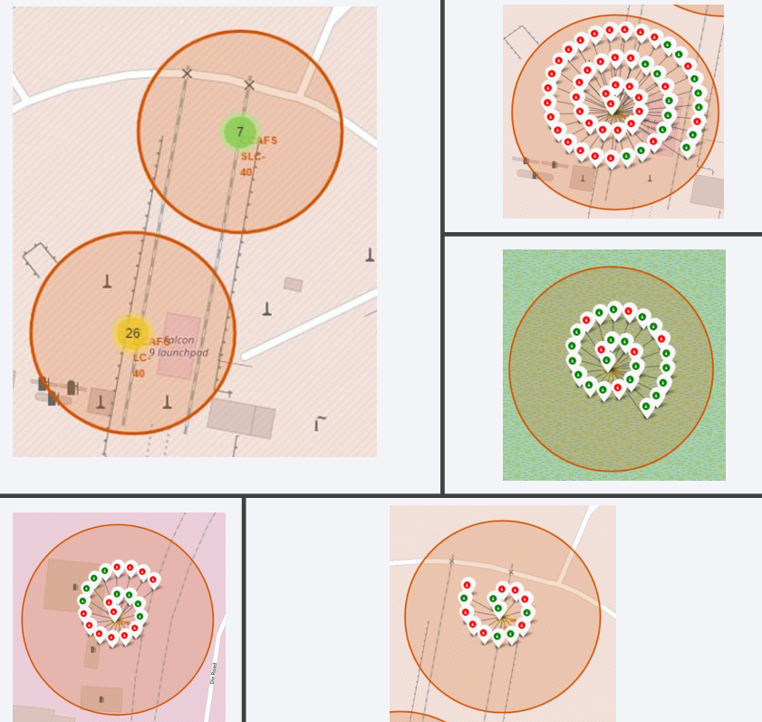
Markers showing launch sites with color labels
Green markers show the successful launches while red shows failures.

Slide 37

Launch Site distance to landmarks

Slide 38

Section 4

Slide 39
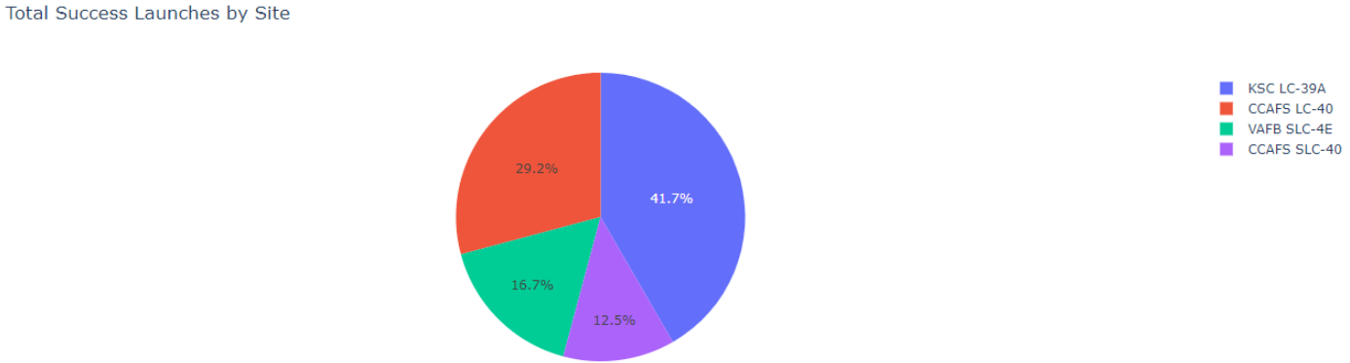
Pie Chart for Success Percentages by all sites
According to the pie chart, KSC LC-39A had the largest number of successful launches among all sites and it was 41.7%.

Slide 40
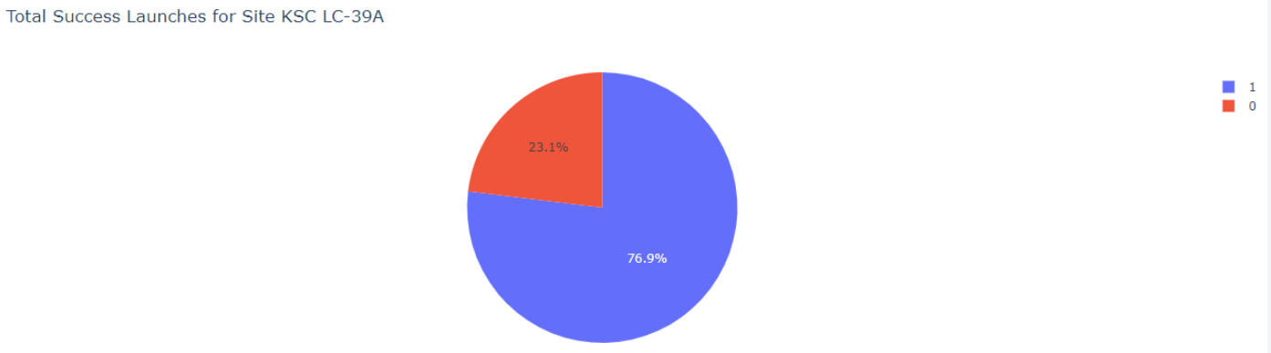
Pie Chart for the launch site with highest success ratio
KSC LC-39A achieved a 76.9% success rate, while getting a 23.1% failure rate.

Slide 41
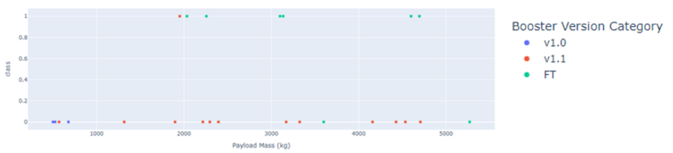
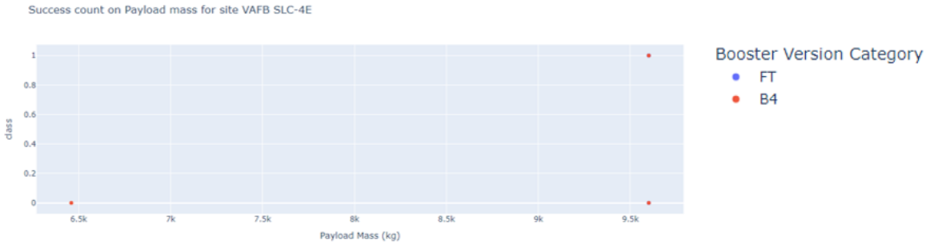
Scatter plot of Payload vs Launch Outcome for all sites, with different payload selected in the range slider
The first figure shows for the site CCAFS LC40 for the lower payload and FT booster version had the highest success count.
The second plot indicates for the site VAFB SLC4E for the higher payload. But one launch from the version B4 had succeeded.

Slide 42

Section 5

Slide 43
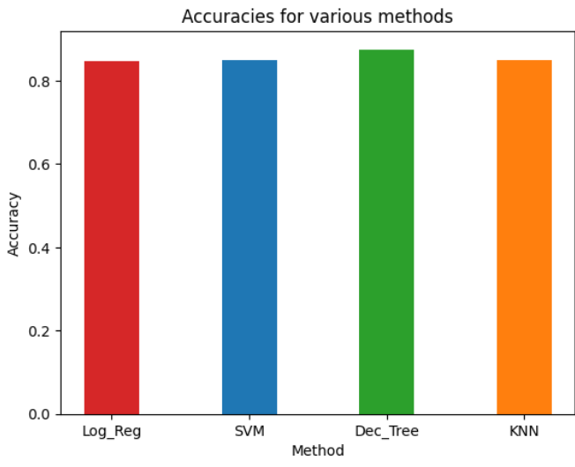
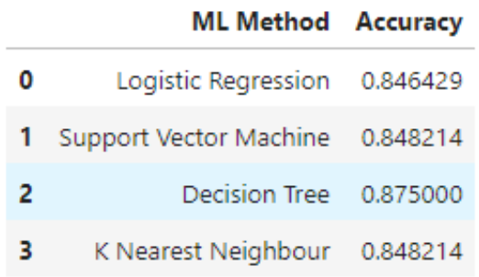
Classification Accuracy
The decision tree classifier is the model with the highest classification accuracy

Slide 44

Confusion Matrix
The confusion matrix for the decision tree classifier shows that the classifier can distinguish between the different classes. The major problem is the false positives .i.e., unsuccessful landing marked as successful landing by the classifier.

Slide 45
Conclusions
We can conclude that :
The larger the flight number at a launch site, the greater the success rate at a launch site.
Orbits ES-L1, GEO, HEO, SSO, VLEO had the most success rate.
KSC LC-39A had the most successful launches of any sites.
Launch success rate started to increase from 2013 to 2020.
The Decision tree classifier is the best machine learning algorithm for this task.

Slide 46


